Slide 1

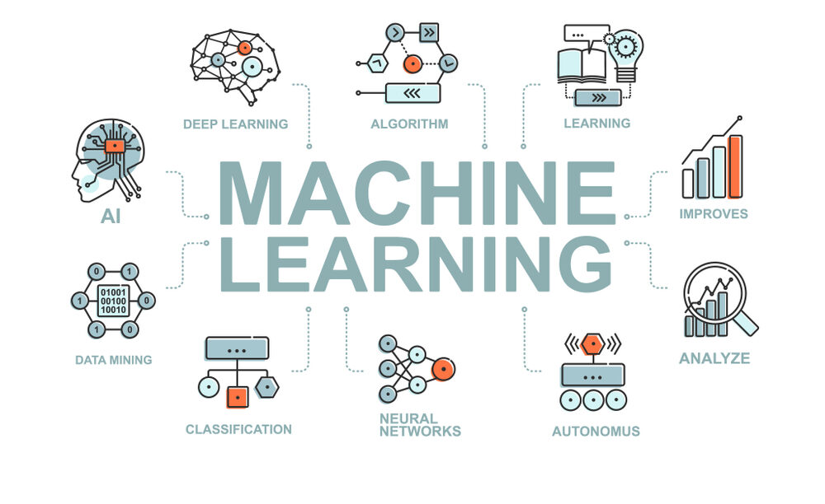

Embedded machine learning
BASSEL YASSER MAHMOUD

Slide 2


Slide 3

WHY MACHINE LEARNING ??
Some real life examples of machine learning

Slide 4
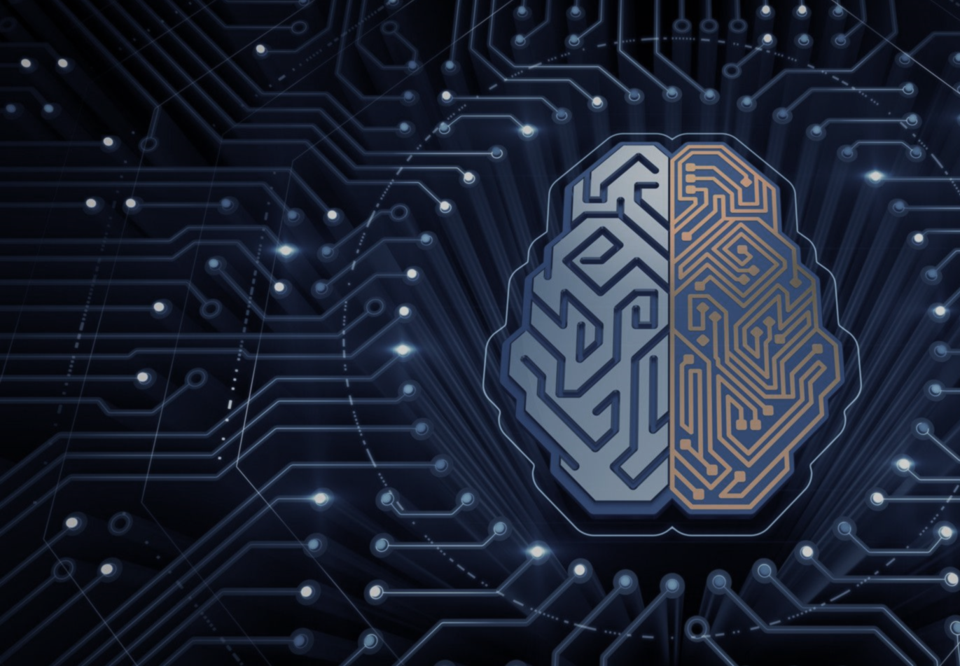
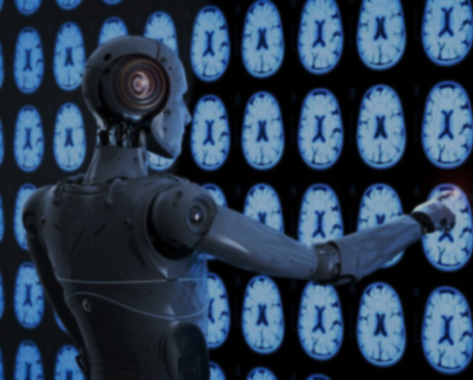
WHY MACHINE LEARNING ??
Some real life examples of machine learning
Healthcare and medical diagnosis
Face detection in images
Commute predictions
Agriculture
Smart assistants

Slide 5
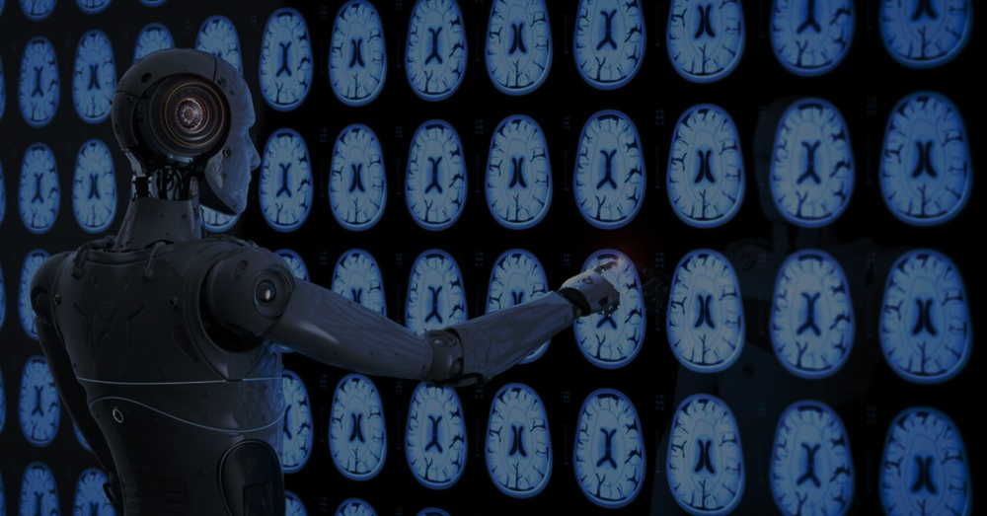
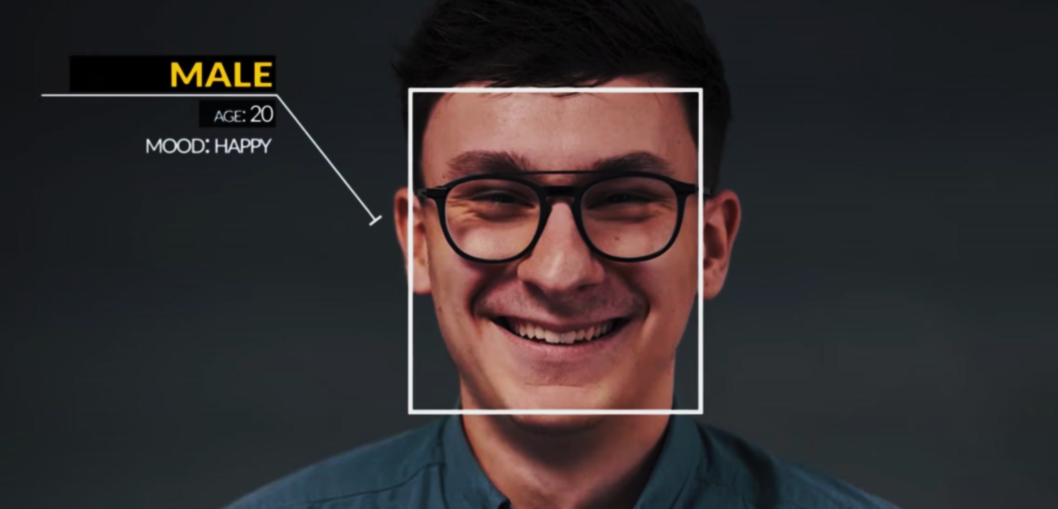
Some real life examples of machine learning
Healthcare and medical diagnosis
Machine learning deals with warning and diagnostic issues in medicine and healthcare. Disease breakthroughs, patient monitoring and management, medical data analysis.
Face detection in images
Commute predictions
Agriculture
Smart assistants

Slide 6
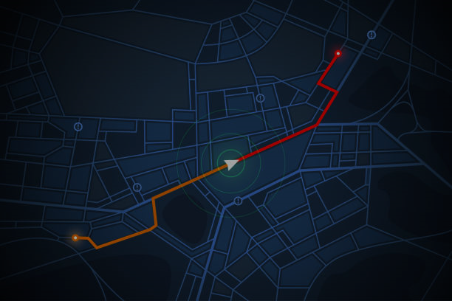
Some real life examples of machine learning
Healthcare and medical diagnosis
Face detection in images
Machine learning finds its application in face detection amidst non-face objects such as buildings, landscapes, or other human body parts, such as legs or hands. It plays a crucial role in fortifying surveillance techniques by tracking down terrorists and criminals, making the world a safer place
Commute predictions
Agriculture
Smart assistants

Slide 7

Some real life examples of machine learning
Healthcare and medical diagnosis
Face detection in images
Commute predictions
Machine Learning in platforms that use maps and routing ensures punctuality through ML algorithms to calculate the quickest route having less traffic, arrival time, the pick-up location, and the best optimal route to a destination.
Agriculture
Smart assistants

Slide 8
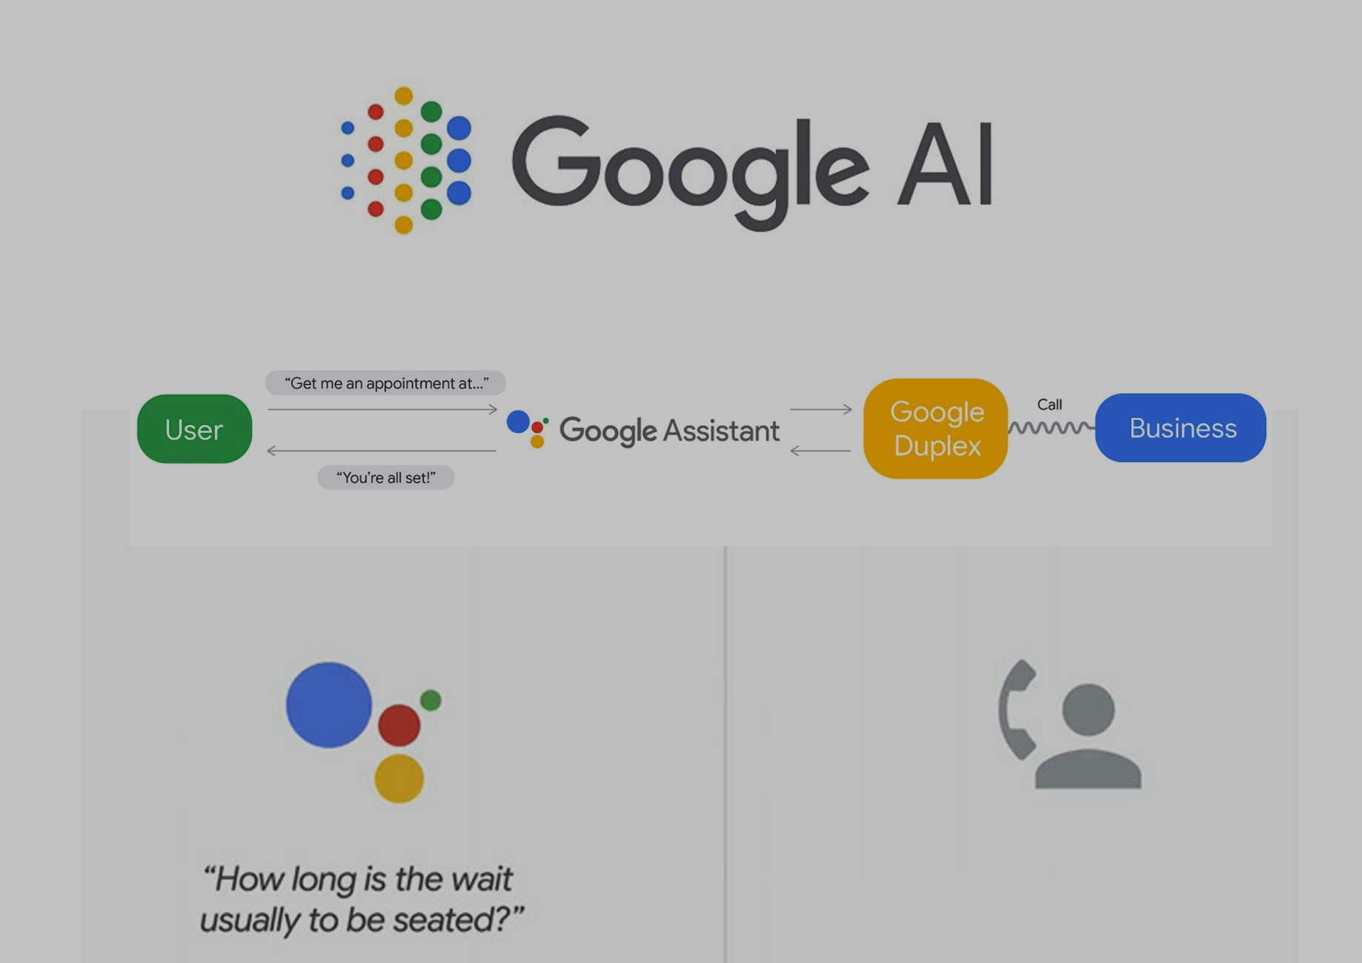
Some real life examples of machine learning
Healthcare and medical diagnosis
Face detection in images
Commute predictions
Agriculture
Machine learning in agriculture enables precise and efficient farming with less manpower for high-quality production.
Smart assistants

Slide 9
Some real life examples of machine learning
Healthcare and medical diagnosis
Face detection in images
Commute predictions
Agriculture
Smart assistants
Siri, Alexa, and Google Assistants are just some of the smart assistants used in everyday life to carry out activities like setting reminders, alarms, checking the weather, etc.

Slide 10
What is Machine learning

Slide 11

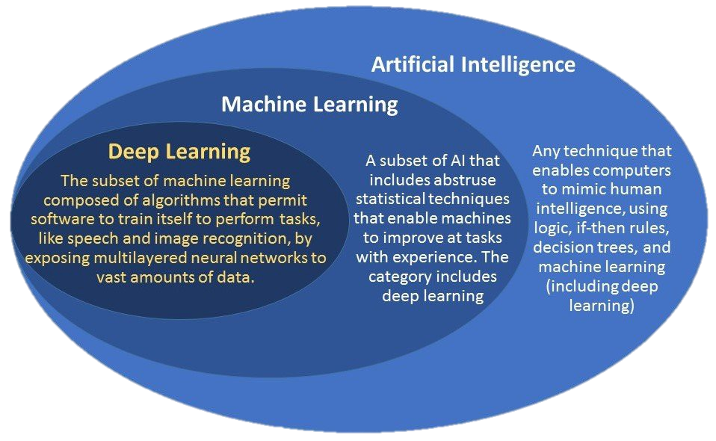


What is Machine learning
A subset of artificial intelligence (AI) and computer science, machine learning (ML) deals with the study and use of data and algorithms that mimic how humans learn.

Slide 12
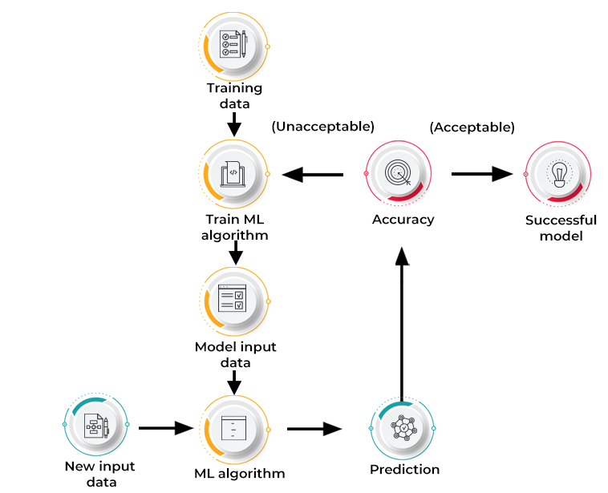
How does machine learning work

Slide 13
How does machine learning work

Slide 14
Let’s first know
TYPES OF
MACHINE LEARNING
☺
TYPES OF MACHINE LEARNING

Slide 15

TYPES OF
MACHINE LEARNING

Slide 16

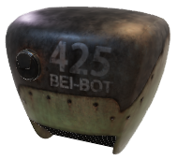

TYPES OF
MACHINE LEARNING
Supervised
Learning
Reinforcement
Learning
Unsupervised
Learning

Slide 17
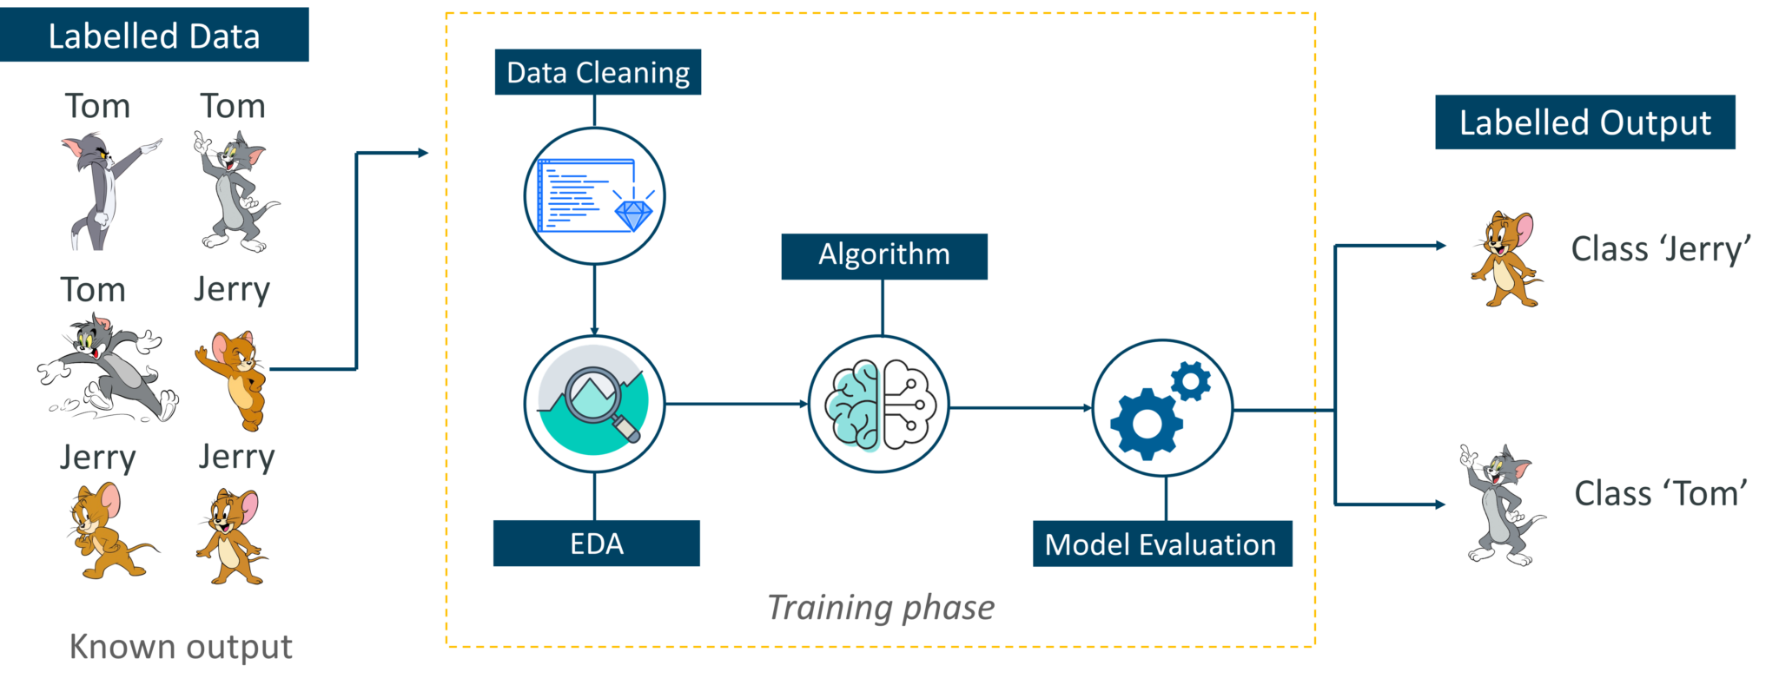
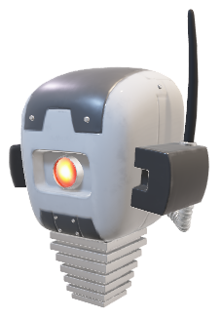
TYPES OF
MACHINE LEARNING
Supervised learning

Slide 18
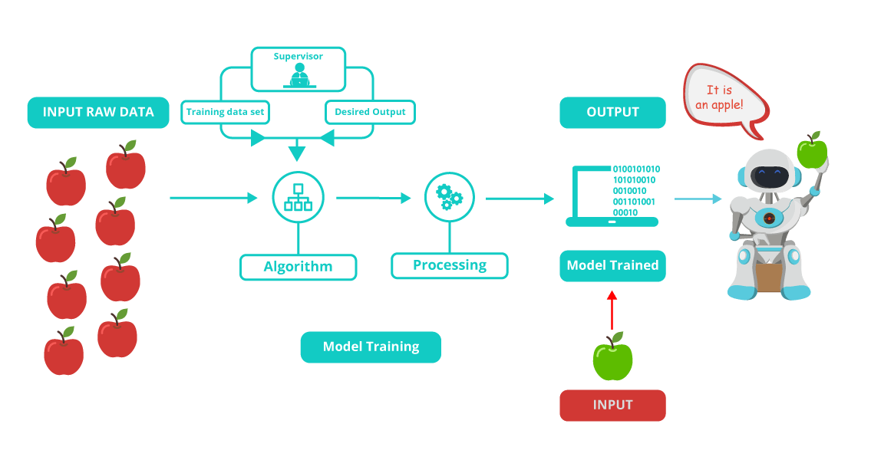
TYPES OF
MACHINE LEARNING
Supervised learning

Slide 19

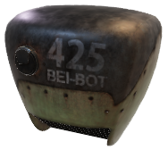

TYPES OF
MACHINE LEARNING
Supervised
Learning
Reinforcement
Learning
Unsupervised
Learning

Slide 20
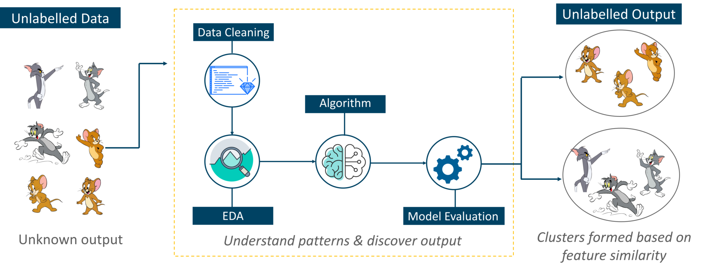


TYPES OF
MACHINE LEARNING
Unsupervised learning

Slide 21
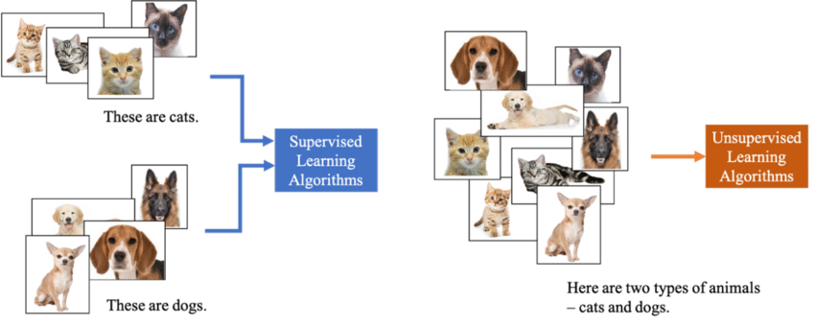
Supervised vs unsupervised

Slide 22
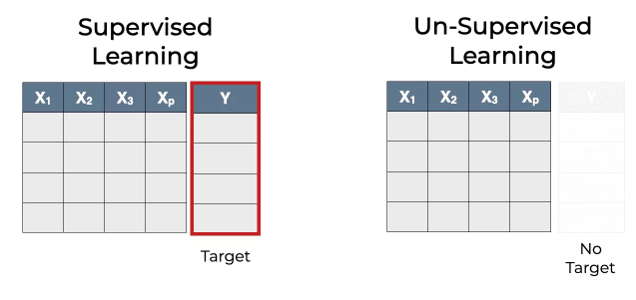
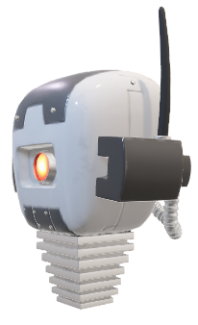
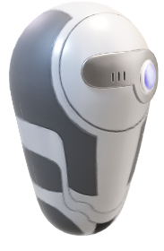
Supervised vs unsupervised

Slide 23
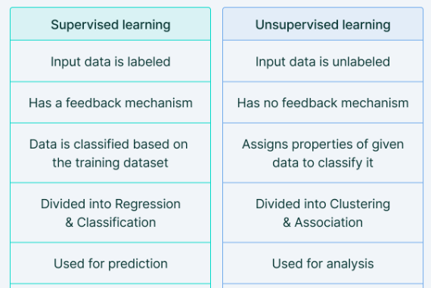
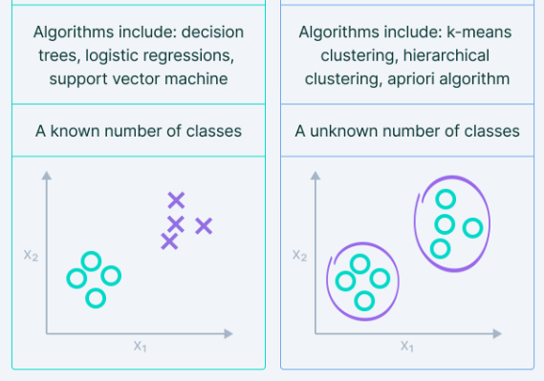

Supervised vs unsupervised
TYPES OF
MACHINE LEARNING

Slide 24
TYPES OF
MACHINE LEARNING
Supervised
Learning
Reinforcement
Learning
Unsupervised
Learning

Slide 25
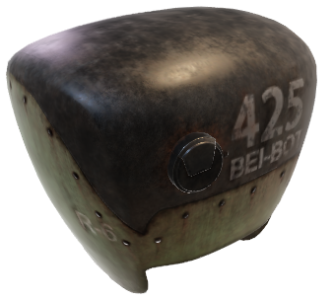
TYPES OF
MACHINE LEARNING
Reinforcement learning
Embedded Machine Learning

Slide 26
Embedded Machine Learning!!
Microcontrollers for machine learning

Slide 27
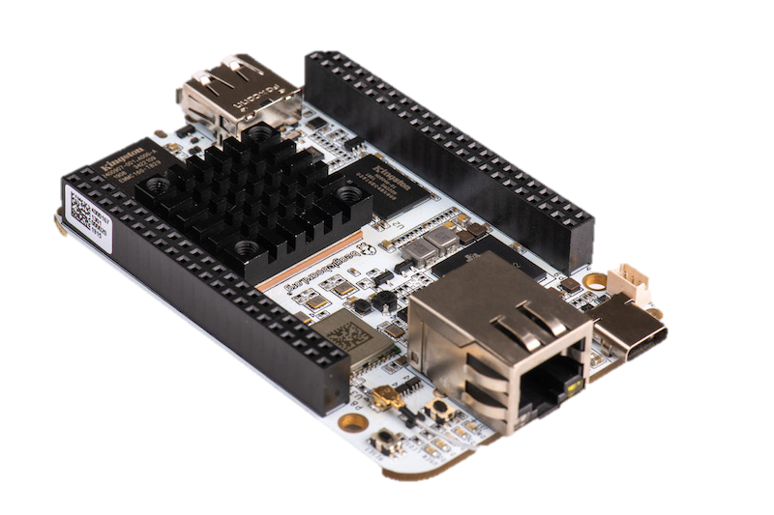
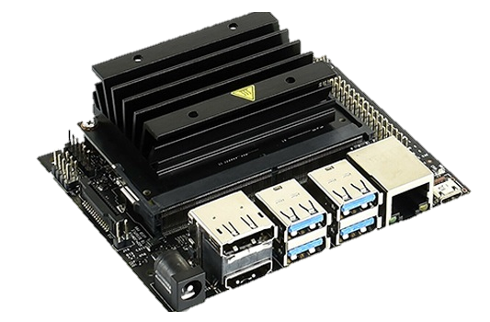
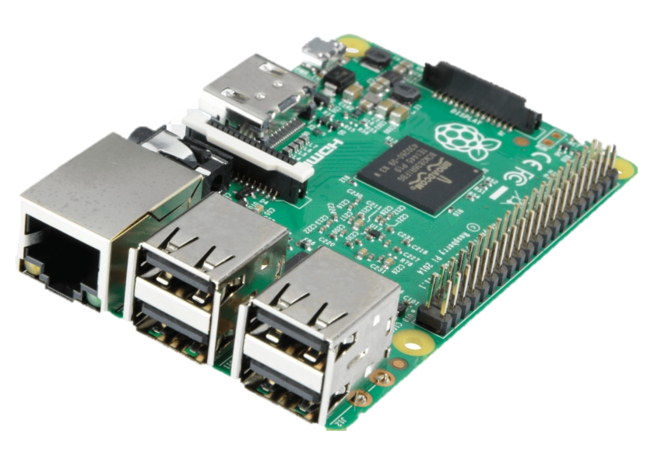
Embedded Machine Learning!!
Microcontrollers for machine learning
Beaglebone
Raspberry pi
Jetson nano

Slide 28

Thank You!
baselyasser5400@gmail.com

Slide 30

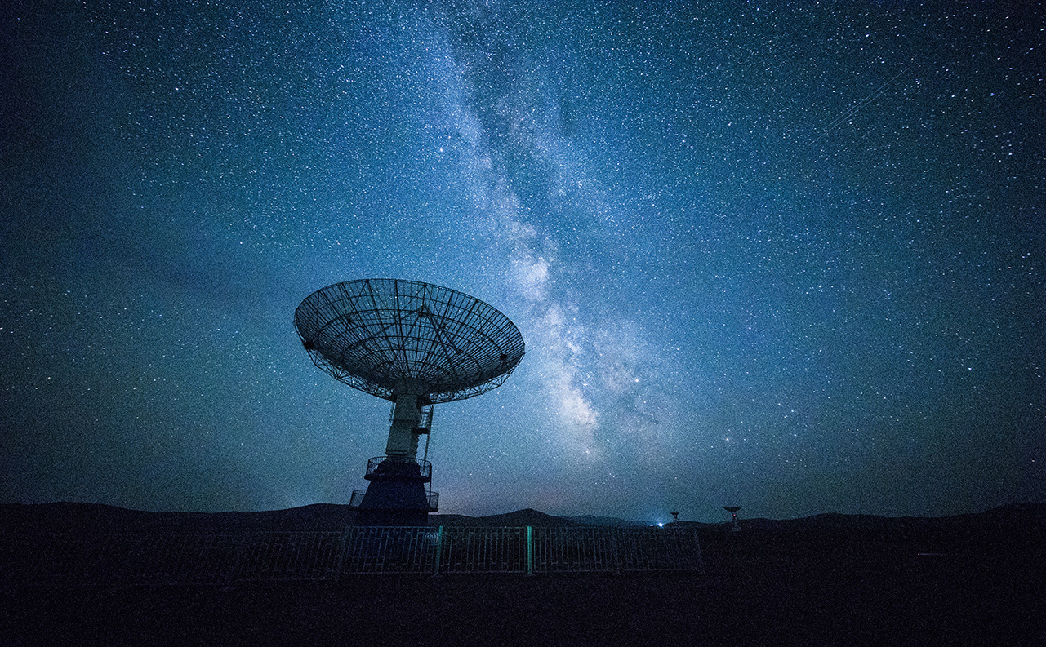
What is Machine learning
Smart Product
Voice Recognition
Artificial Intelligence
VR

Slide 31
Network Technology
Problem Solving
Algorithm
Automation

